Slide 1
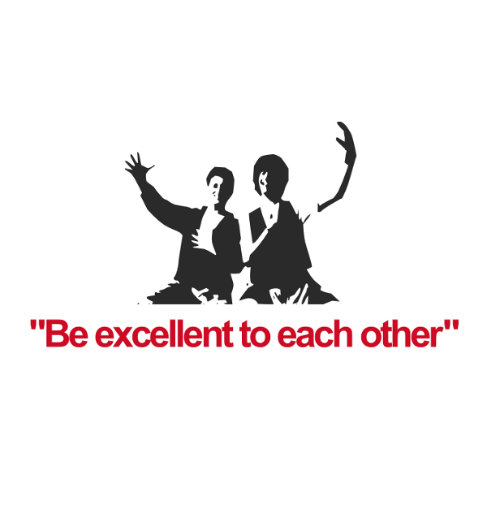
Above all else

Slide 2

You can use the white tables

Slide 3
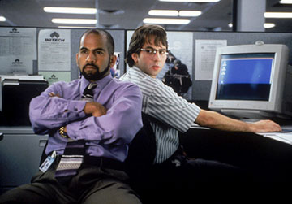
Respect our Office Space

Slide 4
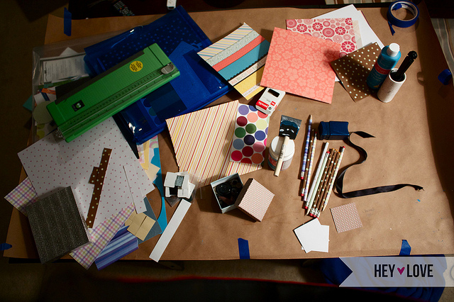
Do it on the THS table

Slide 5
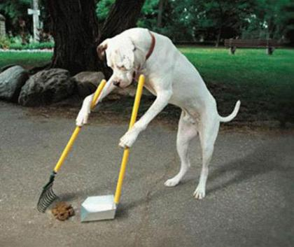
Need I say more?

Slide 6

Throw it away!
Non Burnable:
* Drink Cans * Bottles
* Plastics * Small electronic parts * Clean Plastics
Burnable:
* Food * Paper bags and wrappers
* Dirty plastics * Small cardboard

Slide 7
Membership
5000 yen per month
You get
A space to store one (1) box for your projects
Access to the space anytime (using passmo/suica)
Discounts on all events and classes
Free or discounted parts and supplies
Awesome group of people to work on projects with!

